Slide 1
Next Hikes IT Solutions
Exploratory Data Analysis (EDA) for Real Estate Pricing
This project focuses on Exploratory Data Analysis (EDA) of Real Estate Pricing. It involves cleaning and analyzing property data based on factors like location, size, and amenities to identify patterns influencing prices. Through visualizations and statistical insights, the study highlights how these factors impact market trends and supports data-driven pricing decisions.
Abdus Samad

Slide 2
Exploratory Data Analysis (EDA) for Real Estate Pricing
Problem Statement -
Context: Determining a competitive house price is complex due to many influencing factors . We aim to analyze these factors to help price properties optimally.
Objective: Use EDA to uncover key variables, patterns, and trends that influence residential property values . Insights will support strategic pricing decisions and reveal opportunities for value optimization.
Dataset Overview - Data source: “Housing Data.csv” with 1,460 records of residential sales. It contains ~80 features per property (e.g. location, size, amenities, etc.). Key features: Includes sale price, living area (sqft), lot size, year built, number of bedrooms/bathrooms, neighborhood, and various amenities (garage, fireplace, pool, etc.). These cover diverse parameters affecting home values.
Libraries Used –
NumPy: For numerical operations Pandas: For data cleaning and manipulation Matplotlib & Seaborn: For data visualization
SciPy: Used for statistical analysis and hypothesis testing.

Slide 3
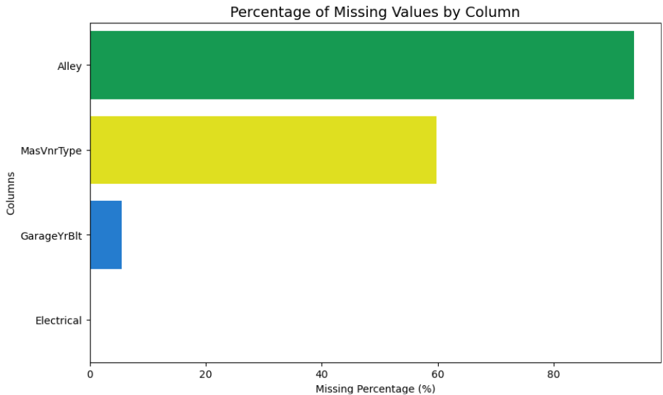
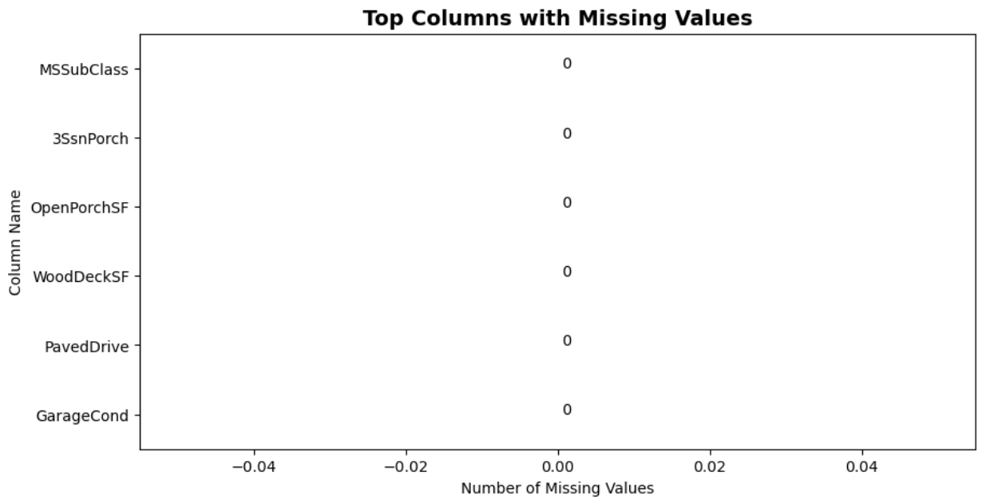
Exploratory Data Analysis (EDA) for Real Estate Pricing
Data Cleaning -
Duplicates & Irrelevant data: Verified 1,460 unique entries (no duplicates). Removed the redundant index column (‘Unnamed: 0’).
Missing values: Identified columns with excessive NAs (e.g. Alley with >92% missing) and
dropped them. For other missing entries, performed imputation (mode for categorical, etc.) to preserve data integrity. Consistency checks: Ensured all remaining features have valid formats and ranges, ready for analysis.
BEFORE
AFTER

Slide 4
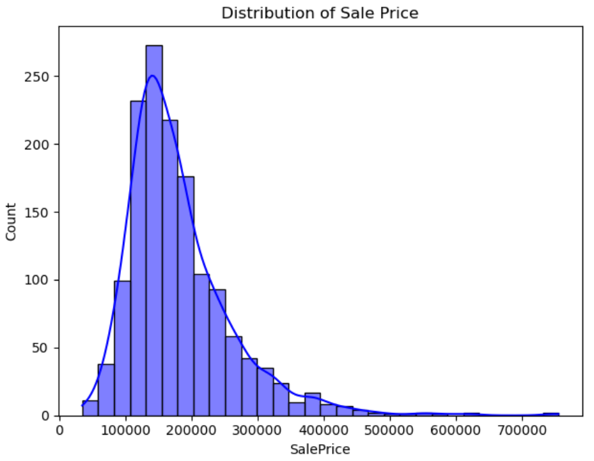

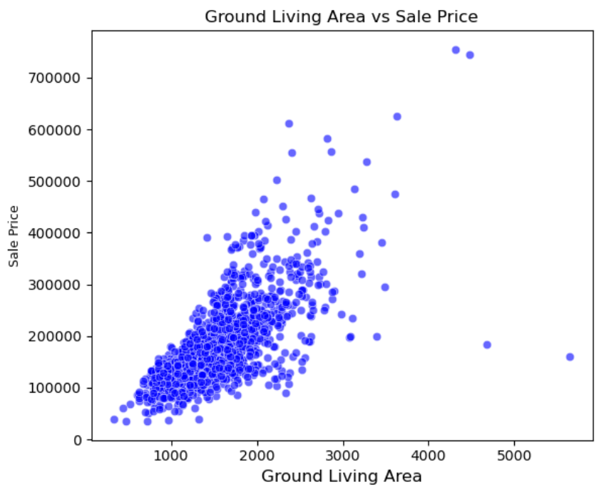
Univariate Analysis
Sale Price distribution The sale price distribution is right-skewed (most homes at lower prices
with a long tail of expensive properties). We will use a histogram/KDE to visualize this
distribution
Other variables
Examined individual numeric features (e.g. OverallQual, GrLivArea, LotArea).
Each variable’s distribution (via histogram or boxplot) helps identify typical values and outliers

Slide 5
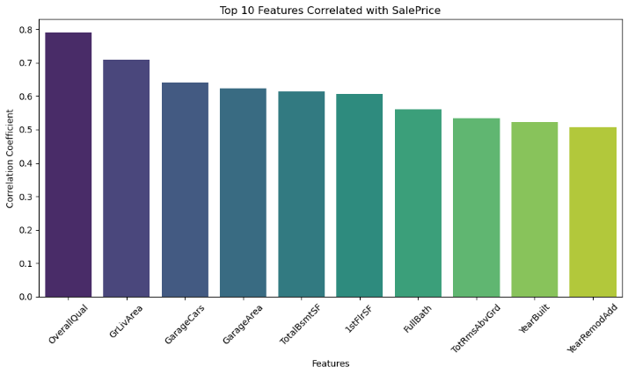
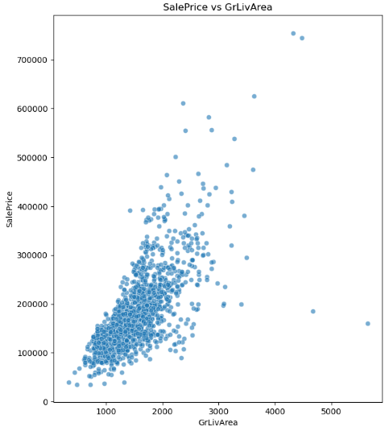
Multivariate Analysis
Correlations
Plotted pairs of interest (e.g. GrLivArea vs SalePrice, YearBuilt vs SalePrice) to inspect trends. Generally, larger homes or newer homes sell for higher prices. Scatterplots will reveal these trends and any clusters/outliers
Scatter plots
Computed a correlation matrix to find relationships among features and with SalePrice . For example, living area and bedroom count positively correlate with price. We’ll visualize this with a heatmap.

Slide 6
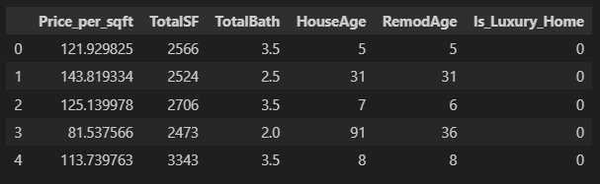
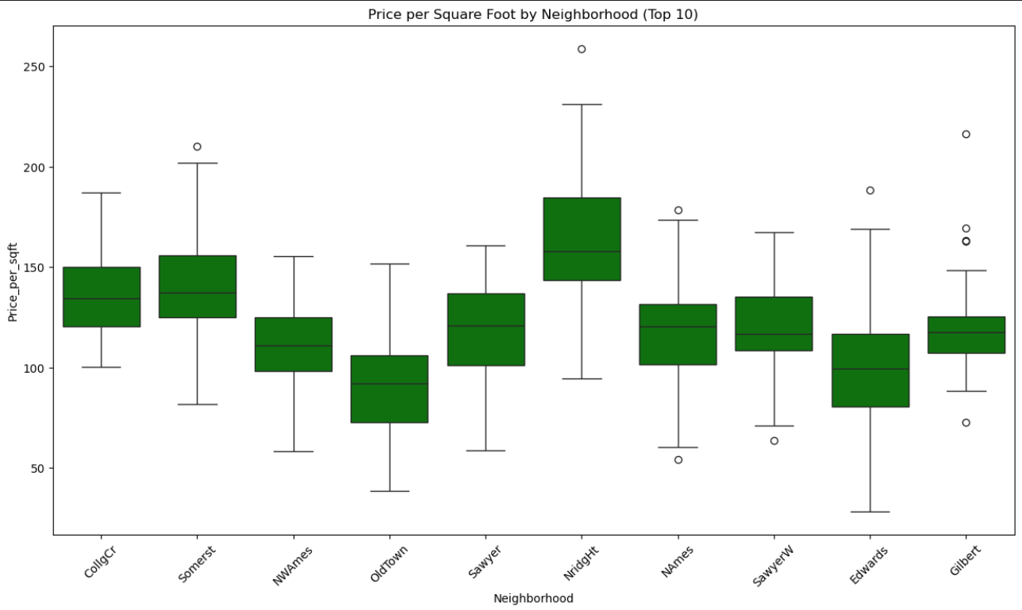
Feature Engineering
New features created
TotalSF = TotalBsmtSF + 1stFlrSF + 2ndFlrSF (combined total sqft).
Pricepersqft = SalePrice / GrLivArea (price per above-ground sqft).
TotalBath = BsmtFullBath + BsmtHalfBath + FullBath + HalfBath (all bathrooms).
HouseAge = YrSold – YearBuilt (age at sale), RemodAge = YrSold – YearRemodAdd.
Binary flags like HasPool, HasFireplace, HasGarage to indicate amenities.
These capture pricing factors beyond raw features
Analysis of new features
For example, GrLivArea (above-ground living area) shows a strong
positive linear relationship with SalePrice . We also examine Price_per_sqft by neighborhood to
see local pricing differences.

Slide 7
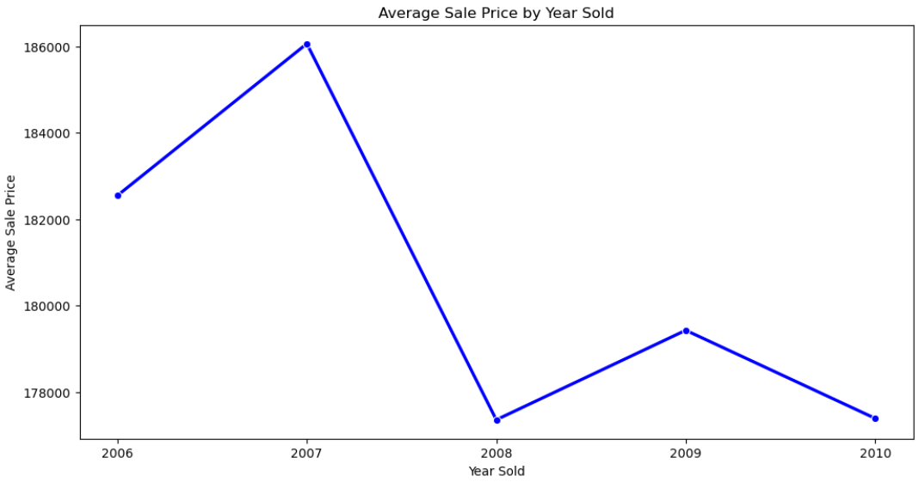
Market Trends & Insights
Time trends: Analyzed SalePrice over years sold. The time series of average prices by year highlights market trends (e.g., rising prices during boom years)
Key insights: The analysis identifies outliers (very high-priced homes) and trend patterns. We also summarize findings such as which features (size, amenities, location) most impact price. For example, homes with luxury amenities (pool/fireplace) or in certain neighborhoods showed higher prices, suggesting customer preference influences price.

Slide 8
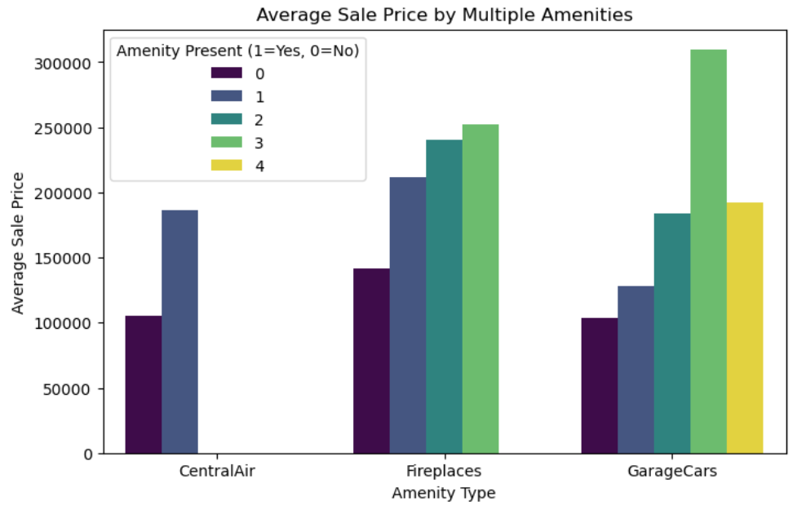
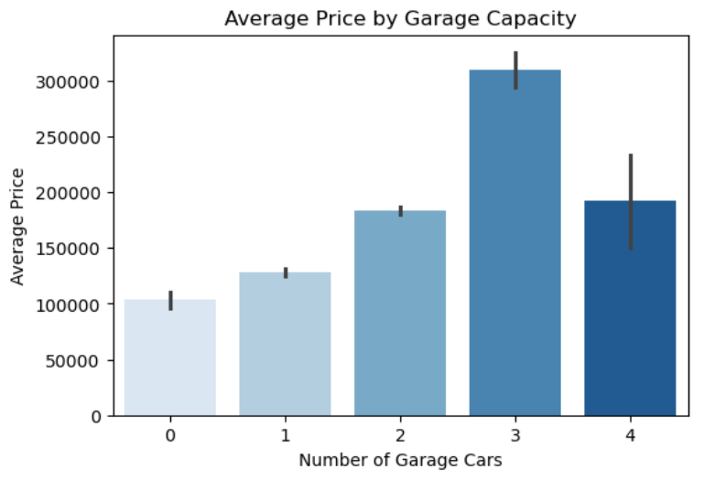
Customer Preferences & Amenities
Insights: Houses with multiple amenities such as central air conditioning, garages, and fireplaces show notably higher sale prices.These features enhance comfort and desirability, making them key factors that boost overall property value.
Insights: Homes with larger garage capacity generally command higher sale prices.More parking space adds utility and buyer appeal, making it a key factor in property valuation.

Slide 9
Conclusion
This analysis sheds light on the most influential factors shaping house prices, from size and quality to amenities, location, and market timing. These insights provide a strong, evidence-backed foundation for smarter pricing, investment, and marketing strategies. Looking ahead, applying advanced regression models will allow for more accurate price predictions, helping both sellers and investors make data-driven decisions with confidence.

Slide 10
RESOURCES
Some various online tutorials & DigiCrome learnings are helpful to handling the data by EDA & Data Visualization.
Helpful Links:
https://www.geeksforgeeks.org/python/data-wrangling-in-python/
https://www.geeksforgeeks.org/data-analysis/what-is-exploratory-data-analysis/

Slide 11
THANKS

